Slide 1
JAVA ASSOCIATION AND THEIR TYPES
-Pranali chougule

Slide 2
Association
Association in Java is a relationship that defines the relationship between two classes that are independent of one another. It represents Has-A relationship.
Association is one of the core concepts of object-oriented programming in Java.
It indicates how objects of classes communicate with each other and how they use the functionality and services provided by that communicated object.
Association establishes a multiplicity relation between objects where all objects have their own lifecycle and there is no owner of association (Has-A relationship).
A multiplicity indicates a number that specifies how many objects of the class are involved in the relationship.
Real-time example is Teacher and Student realtionship

Slide 3
class Teacher {
String name;
Teacher(String name) {
this.name = name;
}
}
class Student {
String name;
Student(String name) {
this.name = name;
}
}
public class School {
public static void main(String[] args) {
Teacher teacher = new Teacher("Mr. John");
Student student = new Student("Alice");
System.out.println(teacher.name + " teaches " + student.name);
}
}
In this case, there’s an association between Teacher and Student since a teacher teaches a student, but they are independent entities.

Slide 4
Types of Relationships Managed by Association
1. Unidirectional Association:
If an object associates with another object, it is called unidirectional association. It is also called one-way relationship.
For example, a department in college can have many students but vice versa is not possible. This is an unidirectional in nature.
2. Bidirectional Association:
When objects involved in association communicate with each other, it is called bidirectional association.
A very common example of bidirectional relationship is “Person and Address”. We can have bidirectional many-to-many relationship between person and address objects.

Slide 5
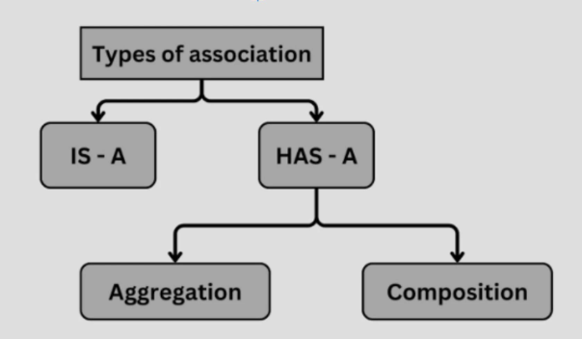
Types of Association

Slide 6
Aggregation
An aggregation is a special form of unidirectional association that represents an ownership relationship between two objects.
It Known as a "has-a" relationship where one class contains a reference to another class, but both classes can exist independently.
But the lifecycles are not tied together.

Slide 7
class Library {
String name;
Library(String name) {
this.name = name;
}
}
class Book {
String title;
Book(String title) {
this.title = title;
}
}
public class AggregationExample {
public static void main(String[] args) {
Library library = new Library("City Library");
Book book = new Book("Java Programming");
System.out.println(book.title + " is available at " + library.name);
}
}
In this example, Library aggregates Book, meaning that books exist in the library but also independently
.

Slide 8
Composition
A composition is a special and more restrictive form of aggregation.
It also represents Has-A relationship where an object cannot exist on its own.
The “whole” is actually dependent on the “part”.
If the parent object is destroyed, then the child object is also destroyed.

Slide 9
class Engine {
String type;
Engine(String type) {
this.type = type;
}
}
class Car {
Engine engine;
Car(String engineType) {
this.engine = new Engine(engineType);
}
}
public class CompositionExample {
public static void main(String[] args) {
Car car = new Car("V8");
System.out.println("Car has an engine of type: " + car.engine.type);
}
}
In this case, Car is composed of an Engine. If the Car object is destroyed, the Engine will also cease to exist.

Slide 10
Benefits of Association
Classes remain separate and manageable, enhancing code structure. The code becomes more modular and easier to understand.
We can reuse the classes in different contexts by establishing associations. It reduces redundancy and enhances code reusability.
Association provides flexibility, as we can accommodate modifications in one class without affecting the entire system.
Interaction between classes is controlled, improving security.

